Slide 1
 |  | wellness works
Empower your employees with financial wellness
Brad Vaughan
T. Rowe Price
October 12, 2016
Notes:
Financial wellness is one of the hottest topics in the retirement space today. Not a day goes by that there isn’t some article or newsletter about the topic hitting our inboxes. But why and how is financial wellness a differentiator? And is your company ready to embrace a financial wellness program?

Slide 2
Overview
What is financial wellness?
Why should you care about it?
Is your company a good candidate for a financial wellness program?
Tools and resources that help you
put financial wellness into action.
Notes:
Let’s quickly give you an overview of our discussion today. We are going to provide you with the What, So what, and Now what of Financial wellness.
What I mean by that is…First, we’re going to define what we mean by financial wellness.
Then, the so what? Why should anyone care? How does it benefit you, and your participants?
And lastly, the now what – some ideas and conversation-starters that you can use to help determine if your company may be a good candidate for a financial wellness program; and then we’ll leave you with a resource that helps you navigate what is quickly becoming a crowded financial wellness marketplace.
But first – how did we get here?
But first we have to decipher: why have we only heard about financial wellness in the past several years? And that’s because…a major wrong was committed against the financial services industry 40 years ago.
A Doctor by the name of Bill Hettler co-founded the National Wellness Institute way back in 1977. And when he co-founded this institute, he said that there are six dimensions to wellness: physical, emotional, occupational, spiritual, social, and intellectual. He left FINANCIAL wellness out!
I can only assume that because there was no FINANCIAL dimension of wellness included there, that’s why we have now only heard of financial wellness with any frequency.
So now that it’s finally becoming more prominent in the retirement industry, 40 years after the Wellness Institute was founded, we want to help you make sense of, and take advantage of, the financial wellness opportunity.
Financial wellness has exploded as a priority in our industry as we recognize that talking about the retirement plan and making recommendations about savings levels in isolation is never going to be ultimately successful because that’s not how people think about their financial picture and make financial decisions. Financial wellness looks at the broad, complex financial picture and helps people make decisions within that context. Using that approach, we will be successful at achieving our retirement goals.

Slide 3
Historical objectives of retirement plan education
Increase Participation
Increase Deferrals
Asset Allocation
Notes:
15 to 20 years ago, when you sat down with your benefits committee or advisor to craft an annual retirement savings education strategy for your employees, it likely focused on three primary objectives: increase participation, increase deferrals, and help them with proper asset allocation.
In fact, the most recent PSCA survey still indicated that retirement plan sponsors thought the top two measures of education program success are participation rates (at 91%) and deferral rates (at 81%).
Fast forward to today, and innovations in plan design and investment solutions have been able to solve for a good chunk of those three legacy objectives of participant education.

Slide 4
Innovations to plan design and investments have helped…
Automatic Enrollment
96%
of participants remain in the plan
Source: T. Rowe Price Retirement Plan Services, Inc. as of 9/30/2015
Notes:
However, the conversation has changed. Over the course of the last two decades, innovations to both plan design and investments can now solve for the lion’s share of those three legacy education objectives. Auto-enrollment – used by roughly half of sponsors in the industry – has had a huge impact on participation rates. As an example, 96% of participants who were auto-enrolled in a T. Rowe Price retirement plan remain in the plan.

Slide 5
Innovations to plan design and investments have helped…
Automatic Increase
66%
of participants remain in the service when it’s offered on an opt-out basis
Source: T. Rowe Price Retirement Plan Services, Inc. as of 9/30/2015
Notes:
When used as an opt-out service, auto-enrollment can gradually move the needle upwards with respect to deferral rates over time –in fact, when used as an opt-out service in conjunction with auto-enrollment, 66% of participants remain in the auto-increase service.

Slide 6
Innovations to plan design and investments have helped…
Automatic Investment into a QDIA
96%
of participants remain in a default fund such as TDF
Source: T. Rowe Price Retirement Plan Services, Inc. as of 9/30/2015
Notes:
And asset allocation products, mainly target date funds thanks to the PPA, get participants into an age-appropriate asset allocation strategy. 96% of participants remain in a target date fund when they are automatically enrolled into one.
So plan design and investment innovations have allowed our education efforts to also evolve over time – to focus on the groups of participants who need the most help. And two HUGE demographics who may be in the most need of holistic financial assistance are: the millennials who are saddled with a ton of college and credit card debt; and the preretiree baby boomers who have to construct a retirement income strategy for their drawdown years.
Now, to be clear, financial problems do not discriminate based on age or income level – participants of ALL ages and income levels can reap the benefits from a financial wellness program. But when you think about why financial wellness has become such a prominent topic over the past few years, the shifting workforce demographics (in addition to plan design and investment innovations) have helped give rise to this notion of financial wellness.

Slide 7
…but have not solved the problem completely.
55%
26%
48%
avoid dealing with their financial situation
expect to run out of money
can’t afford to contribute more to their plans
Source: T. Rowe Price Retirement Saving and Spending Study (2015)
Notes:
But auto-services and asset allocation products can’t solve the entire financial problem for participants.
Even though these innovations have helped drive DC/401(k) participant engagement and success, there is still room for improvement in other areas of their financial lives. These are statistics from a study we conducted last year. 55% of 401(k) participants who say they avoid dealing with their financial situation because it is out of control. 26% of 401(k) participants expect to run out of money in retirement based on their current financial habits. 48% of 401(k) participants contributing below the maximum said that they can’t afford to contribute more because of competing financial priorities.
But don’t take our word for it.

Slide 8
There is opportunity to do more.
Of American adults…
43%
24%
64%
64%
say they are financially illiterate¹
of wages go to consumer debt payments²
say finances are the largest source of stress in their life³
don’t have enough savings to cover a $1,000 emergency⁴
¹S&P Global FinLit Survey 2015
²U.S. Census Bureau at al. 2014
³American Psychological Association 2015
⁴MarketWatch 2015
Notes:
These are statistics pulled from broader industry sources about how there is a lot of room to improve the financial health of American workers.
This presents a huge opportunity for your organization to differentiate itself by providing holisitic financial wellness education. Financial un-wellness is epidemic. Education, and financial behavioral gaps still exist.
24% of income goes to consumer debt payments,
43% of Americans consider themselves financially illiterate.
And this one is a biggie that we’ll talk about later: 64% say finances are the largest source of stress in their life.
and 64% of American workers don’t have enough savings to cover a $1,000 emergency without borrowing.

Slide 9
Good intentions
89%
Although
of sponsors said they were focusing on financial wellness in 2016
20%
only
have a program in place
Source: Aon Hewitt
Notes:
And where do you fall on this issue? Although 89% of plan sponsors said they were focusing on financial wellness in 2016, only 20% currently have an offering in place. These numbers indicate that financial wellness is very top of mind for sponsors, but a lot of them are not quite sure how to address the issue.
Are you in the 89%? Has anyone here gone further down the path of implementing a formal program? Anyone here in the 20%? (Potential opportunity to have them discuss their experience with implementing…the process they went through to evaluate providers. Did they partner with an advisor to explore the landscape?)
So that’s how we got to where we are today, why financial wellness has become so prominent a topic, and the opportunity you have as an employer to improve the financial lives of your employees.
Now, we’ve talked about context and background – let’s define what we mean by financial wellness.

Slide 10



What is financial wellness?
Notes:
So what do we mean when we say financial wellness? The reason we want to explicitly define it is because we’ve heard from many financial industry folks, financial advisors, and plan sponsors, and we quickly learned that the phrase financial wellness means very different things to different people. For example, during a panel on financial wellness at a Pension and Investments summit earlier this year, one of the panelists was a plan sponsor who told the audience that their company’s definition of financial wellness was plan education: power of compounding, tax-deferred investing, making sure to maximize the match, etc.
So for the sake of our discussion today: Financial wellness is defined as the ability of individuals and families to manage daily finances while setting short- and long-term investment goals like:
building an emergency savings “cushion”,
paying off a home mortgage,
setting up a college fund, or
saving more for retirement.
Financial wellness needs span a wide spectrum. At TRP, we identify 3 tiers of financial needs: Foundational (the building blocks of a firm financial foundational, including budgeting, debt management, emergency preparedness), Intermediate (addressing longer term needs like saving for retirement, college, or even paying off the house), and Advanced (more complex needs, like trust & estate planning, income tax planning, income distribution planning)
Financial wellness results from adopting healthy saving and investing behaviors that are attainable and maintainable over time.
The word “MAINTANABLE” has significance here. Because, as we will see later, just because a company has great participation and deferrals rates in their retirement plans, this does not mean that it couldn’t be a prime candidate for a financial wellness program.

Slide 11
Why should sponsors focus on financial wellness?
Notes:
So why now? The desire to help employees save more is as old as the 401k itself. Why are plan sponsors emphasizing holistic financial wellness now?
Several reasons – both from a company’s financial perspective, and from a purely paternalistic perspective. First, the financials…
Let me ask you a question. What is one of the biggest topics of debate going on in this country today? What is one of the biggest concern on the minds of employers today with respect to their company’s costs?
Healthcare.

Slide 12
Sponsor concerns: cost considerations
Healthcare
cost
PAYROLL
Worker’s
Compensation
tenure
Chart is for illustrative purposes only.
Notes:
FIRST CLICK: It’s no secret that older employees are more expensive to insure. And if they are not financially well enough to retire on time, what do you think that’s going to do to a plan’s healthcare premiums? Because most older workers are not hanging onto a job because the like the ambiance or the camaraderie. They are hanging onto the paycheck, and the precious, precious healthcare benefits.
Think about your own situation. Many plan sponsors are very paternalistic. And some that we’ve talked to are of the opinion that “my employees can do whatever they want with their hard-earned money. It doesn’t affect our organization if they save or not. Who am I to automatically enroll them in a retirement plan?” But let’s examine this scenario:
Let’s say you were to call your healthcare provider and ask them to run projections on your company’s health care premiums as if everyone were 20 years older than they are today. You look at the projection and compare it to what you’re paying for healthcare today; and then think about whether or not it’s important for your employees to be able to retire at a reasonable age. Whether your employees save enough to be able to retire on time could have a major impact on your company’s bottom line.
So…healthcare costs are a major reason sponsors and small business owners should consider getting their workforce as financially well as they can. A recent Financial Finesse case study reports that employees cost their employers addl $10k-$50k per year for every year they delay retirement beyond normal retirement age.
SECOND CLICK:
But there are other costs that business owners may want to consider as well.
The next is payroll costs: a 65 year old with 20 years of tenure is probably going to get paid a heck of a lot more than a 30 year old for potentially a similar amount of productivity.
And the third cost – depending on the industry your organization is in – is worker’s comp costs. Manufacturing….construction….any industry with the potential for injury…runs the risk of increasing that potential for injury the longer their workers stay employed past normal retirement age. Obviously these costs vary by industry, but everyone is subject to some worker’s compensation expense.
Now those are explicit costs that are more easy to see because it’s easier to link a hard dollar amount to them. What about the cost of lost productivity?

Slide 13
Strain on worker productivity
70%
of HR professionals surveyed say financial problems impact employee performance.¹
44%
of employers believe that offering additional guidance on handling finances will decrease the time employees spend at work tending to financial issues.²
¹Aon Hewitt
²SHRM, 2014 “Financial Wellness in the Workplace Survey”
Notes:
We saw earlier that 64% of workers say that financial issues are the #1 SOURCE OF STRESS in their lives. That stress, more likely than not, has negative implications on their work life as well. And HR professionals agree with us.
70% of HR professionals surveyed say financial problems impact employee performance — the most cited aspects of which included stress, the ability to focus on work, overall productivity, absenteeism, and tardiness. To sum it up, financially stressed employees can have a seriously negative impact on your bottom line with respect to lost productivity.
Lockton survey says that workers w high stress are 2x as likely to call out sick when they aren’t sick as those with low stress (48% vs. 24%). 10% of those behind track for retirement report being fully productive at work.
The phrase “absence management” is starting to take hold. On June 30th, BenefitsPro facilitated a webinar to explicitly address how employers should address “absence management.”
As it relates to financial wellness, 44% of employers believe that offering financial guidance at work will decrease the time employees spend tending to financial issues. Makes sense!
So cost…..is a huge consideration for plan sponsors, small business owners, CFO-types. If they are throwing up roadblocks about plan enhancements or financial wellness programs based on cost – you have a couple of arrows for your quiver in that conversation. Easier to measure costs like payroll, workers comp, and healthcare, in addition to harder to gauge costs of lost productivity, errors, etc.
Now, what if you’re not the CFO or business owner. What if you’re the HR or benefits manager. You field calls and emails from financially stressed or concerned employees. You’re on the front lines – hearing about financial issues from your workforce. How do you then advocate for a financial wellness program within your firm?
You can say that financial stress is literally KILLING your employees.
A few years ago, researchers at San Diego State University uncovered something interesting. They analyzed all of the Google search data from the financial crisis of 2008 and 2009.

Slide 14

Strain on employees—PHYSICALLY
Finances are the #1 source of stress for Americans.¹
Google searches for STOMACH ULCERS increased
228%
during the
Great Recession²
¹American Psychological Association, 2015
²San Diego State University, 2012
Notes:
They found that during the recession, searches for the phrase “stomach ulcer” were up 228%.

Slide 15

Strain on employees
Finances are the #1 source of stress for Americans.
Searches for Headaches
increased
193%
Notes:
“Headache” was up 193%.

Slide 16

Strain on employees
Finances are the #1 source of stress for Americans.
Searches for CHEST PAINS
increased
35%
Notes:
Chest pain? 35% higher. Now, this gentleman obviously has a right knee issue here. But for some reason, we’re connecting this image with a rise in chest pain searches (wait for thunderous laughter and applause, drop the mic, and walk off the stage now).
AP-AOL Health Poll found that in all cases, reports of health issues are higher for individuals with high stress vs. low. 3x as likely to suffer stomach ulcers, 3x as likely to have headaches, and 2x as likely to have heart attacks
Even backache and toothache were up.
And the sad part is….this doesn’t just affect the employees themselves. Financial stress does not operate in a vacuum. I heard a story on NPR a few weeks ago that broke my heart. The American Academy of Pediatrics has asked that pediatricians start to screen their patients for poverty. Children living below the poverty line have much higher rates of obesity, diabetes, asthma, and toxic stress. Now that’s probably not something that those pediatricians ever thought they were going to have to navigate when they got into the field of medicine. [Link is here if you want to read it: http://www.npr.org/2016/03/10/469972559/pediatricians-urged-to-screen-for-poverty-at-child-check-ups ]. And if you’re a benefits or HR rep who is on the front lines fielding calls from concerned or financially stressed employees and you know those folks have families….that’s a powerful story when you’re advocating for a financial wellness program. Many times, behind every employee is a family unit that also could be suffering the consequences.
The links between physical and financial well-being are beginning to be undeniable.

Slide 17
#1 reason for incorporating financial wellness
85%
of plan sponsors said they want to provide some type of financial wellness offering because…
Notes:
Despite benefits to employers that are as critical to running a successful business as worker productivity and healthcare premiums are, those reasons pale in comparison to the #1 reason sponsors want to focus on financial wellness for their employees.
In Aon Hewitt’s 2016 study on Hot Topics in Retirement Survey, 85% of sponsors surveyed, far and away the top response, said they wanted to provide their employees some type of offering around financial wellness because…. Does anyone want to guess what the number one response was?
[for context, “decreasing medical costs came in 6th in that survey….at only 26%. Behind :
employee engagement: 80%
Improve retirement statistics: 58%
Decrease time spent dealing with financial issues: 44%
Employees are asking for the programs: 33%

Slide 18
#1 reason for incorporating financial wellness
It’s the right thing to do.
Source: Aon Hewitt 2016 “Hot Topics in Retirement” Study
Notes:
“It’s the right thing to do.” Imagine that.
This is consistent with what TRP hears in our conversations with Plan Sponsors. They report Wellness being a broad strategic priority and FW fitting well as an additional component.
We also hear the ability to attract and retain employees. A technology employer told me he worries about losing new salespeople for an additional 1k/year and a manufacturer said people would leave for $0.65/year. When people are not financially secure, they are far more susceptible to the competition.

Slide 19

Financial wellness works for everyone
C-suite
As healthcare concerns continue to mount, providing robust financial wellness solutions could empower employees to retire on time.
Human Resources
A more robust benefits package can a new “R” to the traditional three:
Recruit, Retain, Reward, Retire!
Employees
Financially healthier employees are happier, healthier, and more productive, which can translate to greater business success and increased retirement plan contributions.
Notes:
That’s the beauty of financial wellness.
For employers, it works for both the C-suite and the payroll or benefits manager. And historically, those two groups butt heads when it comes to enhancing the company’s benefits package. Because the payroll manager, who is hearing the financial concerns of the workforce, will recommend to the CFO that they implement a wellness program. And typically, the CFO is going to react unfavorably: “No, we can’t afford it.” But now, there are financial incentives that can validate the need for the CFO, and there are paternalistic reasons that the payroll or benefits manager will like. Financial wellness is an area where those two audiences can finally see eye-to-eye about enhancing their benefits package.
Sponsors have told us that FW is a benefit their employees are genuinely excited about. They know they have problems and see this as a direct benefit to them. Our clients don’t anticipate the same cyncism they often see with health wellness programs that are seen as an opportunity for the employer to reduce their healthcare premiums. A 2015 GuideSpark Survey reported that people are more loyal when they believe their employer has helped them become more financially secure.
And obviously, it works for employees. Because financially healthier employees are happier, more focused, and more productive. That helps the company’s bottom line, it can increase loyalty and employee tenure…and decrease turnover.
Because financial wellness is so new, and it takes time to implement a program and reap the benefits of it…there are not a ton of case studies or examples that reflect wide-scale success. But we were able to get our hands on a few…
Earlier, we looked at both the explicit and implicit incentives for organizations to implement a FW program. Similarly, there are two separate components that employers have seen with respect to the ROI of implementing a program: there are hard dollar costs saved, and they have seen an improvement in the retirement confidence and savings behavior of their workforce.
In the first case, a Fortune 500 company adopted a financial wellness education program from Financial Finesse, and Financial Finesse examined health care costs and rates of absenteeism for employees that enrolled in the program vs. those that did not over a 5-year period. Here is what they found…

Slide 20
Return on investment: reduction in healthcare costs
19.4%
$2.5m
Increase
For Nonusers
Less spent on healthcare for users
4.5%
Decrease
For Program Users
Source: Financial Finesse. Data gathered over a 2-year period ending 2012.
Notes:
Over a two year period (2010-2012), Financial Finesse looked at average healthcare costs for a client company’s workforce. For employees who did not enrolled in the financial wellness program, the firm saw a 19.4% INCREASE in healthcare costs. But for those who enrolled in the program, healthcare costs actually decreased 4.5%! That resulted in an annual savings to the company of $2.5m.
Hard dollar cost savings.

Slide 21
Return on investment: reduction in absenteeism
14.79
hours
27%
10.80 hours
Fewer absentee hours for users
Nonusers
(Average)
Program Users
(Average)
Source: Financial Finesse, 2012.
Notes:
They also looked at absenteeism for one year (2012) for the same client. Non-users of the program missed an average of 14.79 hours of work that year, but those who were enrolled in the program only missed an average of 10.8 hours. Based on the company’s median hourly salary ($25.24), multiplied by the number of program users (9,083), that 3.99-hour decrease resulted in a 27% decrease in hours of work missed for those who participated in the program!
In addition, Financial Finesse measured impact of their program on a number of other areas and saw improvements in all:
Reduction in cost of wage garnishments
Increase in use of flexible spending accounts
Increase in existence of emergency funds
Increase in debt paid off
Increase in deferral rates
Improved confidence
While this industry is still in it’s infancy stage and this is data from just 1 implementation with 1 client, it provides great insight into the many different ways impact can be measured and the potential to deliver significant benefits to both the employer and employee.
And much like we saw earlier in advocating for financial wellness programs from both a cost and paternalistic standpoint….

Slide 22

Return on investment: reduction in stress
and distractions
financial Stress
Financial distractions at work
Source: SmartDollar® program users, 2015.
At start of program
2 - 5 years later
Notes:
….here are the realized psychological benefits to the workforce. These statistics are from employees surveyed by SmartDollar in 2015.
The dark blue bar represents levels of stress and distraction at the start of the financial wellness program. The light blue represents stress levels for program users 2-5 years later.
The extreme effects of overwhelming stress, or employees who reported being “very often distracted” drop significantly – by well over half…just 2-5 years later.

Slide 23
Return on investment: improved outlooks
Improved emotional outlook
retirement preparedness
39%
of program participants who are saving 15% of their salary for retirement after two years
Source: SmartDollar
Notes:
Again, this is SmartDollar 2015 data.
FIRST CLICK:
This chart reflects how employees felt before and after entering a financial wellness program. Before, 61% of employees reported being scared or confused about finances. Add in “indifferent” – not necessarily considered a positive emotion -- and that percentage jumps to 83%. But after enrolling in the program, scared, confused, and indifferent emotions drop dramatically – with just 25% reportedly feeling that way. Whereas, confident and secure jumps to 75%. And this is only 90 days after enrolling in the program!
SECOND CLICK:
And improved emotional outlook pays off…literally. After just 2 years in the program, 39% of program participants were saving 15% of their salary for retirement.

Slide 24
Make the leap from intention to action.
Notes:
So, we’ve defined it. Given you the WHAT?
We’ve talked about the benefits to sponsors. The SO WHAT? And we’ve offered tips on how you can nuance the conversation depending on whether your main POC is the C-suite or the HR manager.

Slide 25
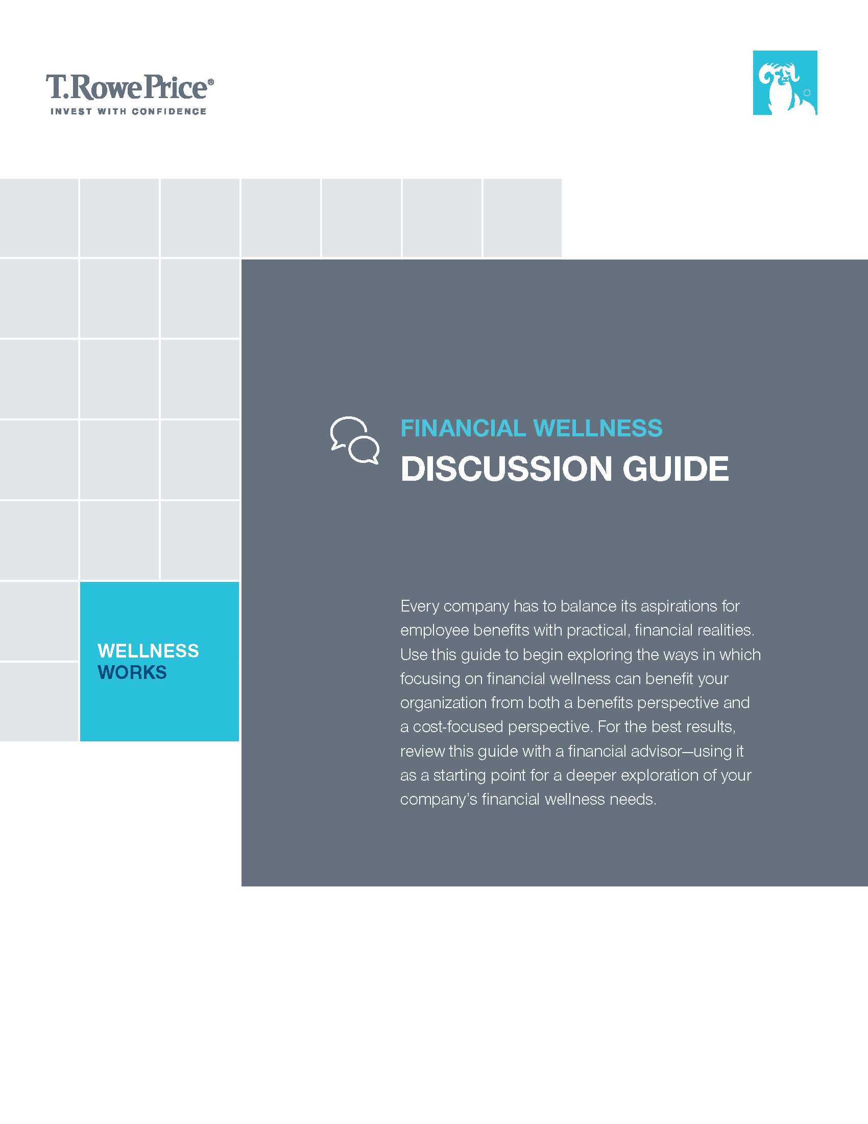
Determine if you’re a good candidate
Evaluate how your company can benefit from a financial wellness program
Identify challenges and resource needs to support a program
Follow a framework to structure the discussion.
Notes:
How can you determine if you are a good candidate for a financial wellness program?
What does that discussion look like?
You can start by looking at three key considerations that may lead a sponsor to decide if they want to implement a financial wellness program:
Plan data
Employee demographics
Corporate culture and philosophy
Let’s first look at plan data.

Slide 26
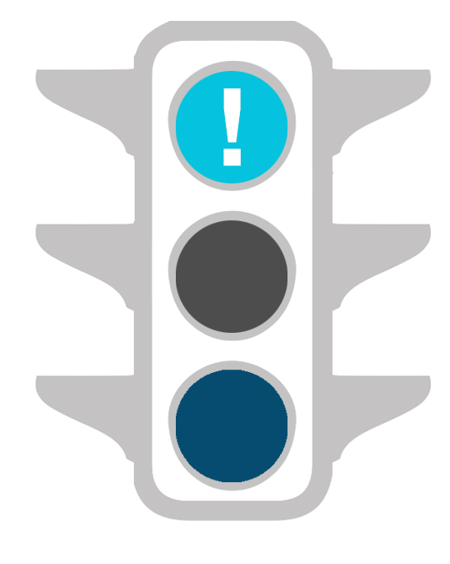
Plan data
Are employees retiring on time with adequate savings?
Are participants opting out of auto-enrollment and auto-increase?
Is there a high volume of
plan-specific Web traffic or calls regarding loans, hardships, or access to money?
96%
66%
Notes:
Now, remember when we defined financial wellness as healthy savings habits that are attainable AND MAINTAINABLE over time? The 2nd and 3rd bullets speak to participants’ ability to maintain their goals. We’ve seen many plans who may have off the charts good participation rates…north of 95%, and average deferral rates of 10% or more, along with great plan-wide asset allocation due to a QDIA default.
But they may also have an unusually high number of loans; or an above-average hardship or in-service distribution rate. It does no good to focus on participation or deferrals if that money is just coming out of the plan on the back end in the form of a loan, hardship, or in-service withdrawal.
For web tracking, if participants are typing in something like “how to access money”….or you are speaking with a benefits coordinator at a plan review and they happen to mention, as an aside, that it seems like they’re receiving more frequent concerns or requests from employees for things like salary advances….that may be symptomatic of financial issues within the workforce.
Many providers have formal mechanisms to capture participant feedback. At TRP, our call center representatives are trained to document feedback if a participant is adamant about something on a call. We call them voicelines. For example, if a plan had 200 participants call in last month, but 100 of those calls were about loan guidelines, distributions, or how to access money, that information can be reported back to the sponsor. If the sponsor was not aware of that feedback or that trend, we may be able to bring that to their attention so they can act on it.
And so, plan data is a logical place to start when evaluating candidates for a financial wellness program.

Slide 27
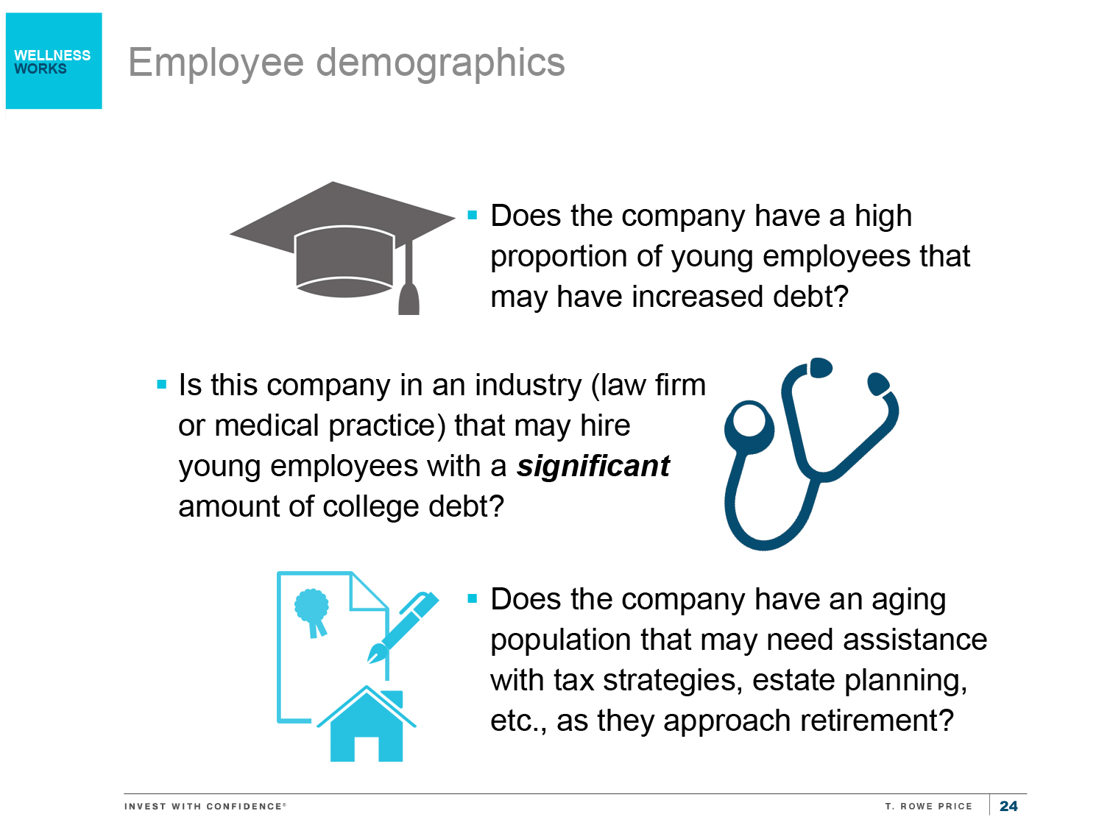
Employee demographics
Does the company have a high proportion of young employees who may have significant debt?
Is the company in an industry (e.g. law firm or medical practice) that may hire young employees with a significant amount of college debt?
Does the company have an aging population that may need assistance with tax strategies, estate planning, etc., as they approach retirement?
Notes:
But even when reviewing plan data, looks can be deceiving. One of the main components of financial wellness is not just setting or working towards attainable short- and long-term savings goals….it’s being able to maintain those savings behaviors over time.
Employee demographics are another critical component to consider when evaluating a plan for the need for a financial wellness program. Are there huge pockets of employees that may be in need of holistic financial guidance or education? For younger employees, as we mentioned earlier, you may have to acknowledge the presence of widespread debt, or CONCENTRATED debt – like you may see in a law practice or doctor’s office or hospital – any profession that requires additional schooling or degrees.
Has anyone ever heard of Student Loan Genius? I saw an article in Retirement Advisor Pro recently that promoted this service. And employers and recordkeepers are partnering with them and offering them to their plan sponsors. It’s a service where, if an employee is paying down student loan debt, businesses can make a pretax contribution to the participant’s account – whether they’re actively participating or not, OR the employer can make a tax-deductible payment to help pay down the loan if the employee enrolls in their DC plan.
It’s a great concept – one that incentivizes those with college debt to improve their financial wellness while saving for retirement…it’s not an either/or scenario.

Slide 28
Corporate culture and philosophy
Is a primary reason for offering a competitive benefits package to recruit, retain, and reward top talent?
Is your company paternalistic, wanting to give employees the best opportunity for replacement income ratios that are superior to the industry?
Are you willing to devote the time and resources to supporting a robust financial wellness program?
Notes:
Corporate culture and philosophy is another method by which to determine readiness to implement a program.
Is a primary reason for offering a competitive benefits package to recruit, retain, and reward top talent? In fact, we were talking with an advisor the other day about the “3 R’s,” and they actually said that their version of the 3 R’s was: Recruit, retain, and RETIRE. I thought that was a nice addition to the traditional reasons for offering a competitive benefits package.
As an employer, are you very paternalistic, wanting to give employees the best opportunity for replacement income ratios that are superior to the industry?
Does someone within the company have the time and resources to do what it takes to make a program successful?
And once you’ve determined (OR…you’ve worked with your advisor to determine) if you’re organization is a good candidate for a financial wellness program, then you can turn to the different options for implementing a program. And while there is no right or wrong way to explore implementing a program, these are the four primary ways that sponsors typically go about implementing:…….
If your advisor has a formal relationship with a financial wellness provider – leverage that partnership to implement a program.
Several recordkeepers have established partnerships with 3rd party financial wellness providers. It may make sense to utilize the relationship that the recordkeeper has.
If you are passionate about the topic and want to take a hands on approach, you can drive the selection process. Motivated plan sponsors may decide that their organization best aligns with a financial wellness provider that neither your advisor nor your recordkeeper utilizes.
The takeaway is…there is no right or wrong way to partner or implement a program. As every advisor’s practice and every client’s set of needs and level of involvement is different, being able to recognize that several options exist and being able to pivot between the different options will help you through the process and make the implementation that much easier for your clients.

Slide 29
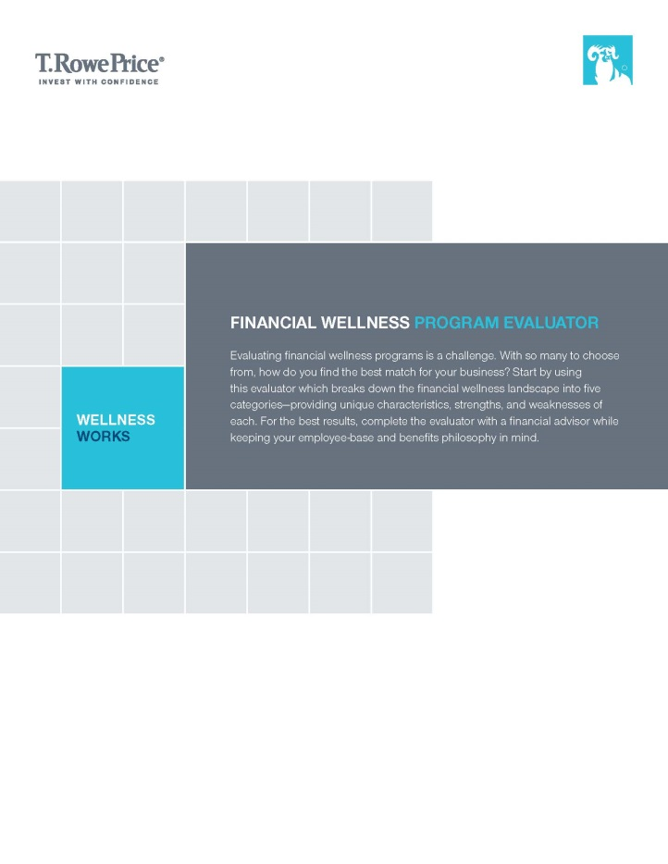
Navigate the provider landscape
Learn the predominant style categories that financial wellness programs adopt
Consider how to match your needs with different styles
Recognize that there is not necessarily a right answer—there may be several good choices today, or there may be one for now and a different one
for later
Notes:
Use our Financial Wellness Program Evaluator to dig into some of the details of popular financial wellness programs. . .how exactly do you determine which program is the best match for your clients?
We have determined that there are five predominate styles of financial wellness program – and each of them may have features that make them a good or not good match for a given company’s needs.

Slide 30
Five styles of financial wellness
Education and Literacy
Services and Products
Tools
Coaching and Behavior Modification
Enhanced Employee Education Program
Notes:
We have found that there are generally 5 main types of ways an organization defines and structures their financial wellness program.
EDUCATION AND LITERACY
As the name suggests, these programs are focused on educating people so that they can make better saving and
spending decisions. They typically don’t work toward specific goals or objectives, but rather offer a broad library of
general content. It is up to the user to figure out which content to view and apply to his or her financial situation. From
the employer’s perspective, there may be no way to keep tabs on which employees are accessing the program and if
they are making progress in addressing financial challenges. Often times this type of financial wellness content is offered by the company or recordkeeper as part of the suite of content they make available to participants.
Think of an Everfi or even Kahn Academy which includes videos on how to learn ANYTHING including financial concepts. Education & literacy approaches are generally less expensive than more comprehensive solutions and could be a good way to start expanding communications for clients without much of a budget, or even clients who just want to dip their toe in the financial wellness waters. There’s no reason that a client can’t later add to their program. TRP has a handful of clients with existing educational FW programs who are currently evaluating S$ as a complement to what already exists.
SERVICES AND PRODUCTS
Product-based services guide people through specific financial planning scenarios. For example, an employee
struggling with estate issues after the passing of a parent might be in need of an estate specialist to develop an
individualized plan. Employer-level reporting varies widely across the Services and Products category, depending on
the provider.
AYCO or even a series of seminars could be examples of solutions in this category. These can be great solutions, but depending on the product might be more on the expensive side. For some clients, this might be a barrier. Another consideration is the delivery model. If these are face to face delivered services, they might work best for a workforce that isn’t geographically dispersed.
TOOLS:
Tools provide a structure to help people manage their money. They rely heavily on the use of financial information
aggregation and may require significant time and ongoing involvement from the user. This type of program often links
together bank accounts, retirement accounts, and other financial sources of information to provide a more complete
financial profile. Think Mint.com or Hello Wallet.
These solutions might be most appropriate for employers with motivated, somewhat sophisticated, and technically savvy employee populations who might be more likely to actively use these types of solutions.
COACHING AND BEHAVIORAL
These programs focus on short- and long-term behavior modification through education and clear next steps.
They usually have lots of content, benchmarks, fewer tools, and robust (often one-on-one) engagement. Coaching and
behavioral programs tend to offer employers the most visibility as to how employees may be progressing on the road
to financial wellness. Reports and statistical information may also help employers evaluate the ROI of a program. SmartDollar could be classified as a behavioral provider (they advocate that the employee complete a series of steps….e.g. first save $1000 for an emergency, then pay off your highest interest debt, then your low interest debt, then start saving for retirement); while someone like Financial Finesse staffs a call center with CFP’s that can help coach you through financial scenarios.
ENHANCED EMPLOYEE EDUCATION PROGRAMS
In some situations, it may not be feasible for employers to purchase a financial wellness program. It may fall to the
financial advisor and Human Resources to create an education program that can enhance an existing retirement
plan education program. The company may be able to identify specific needs within their employee population and
work with an advisor to design educational opportunities around those needs. For example, companies with young
employees who are struggling with college loans might benefit from a presentation on creating a budget. Pre-retirees
may be interested in learning about social security rules, distribution guidelines, or typical healthcare expenses in retirement. The possibilities
are as endless as the employer and advisor’s creativity.

Slide 31
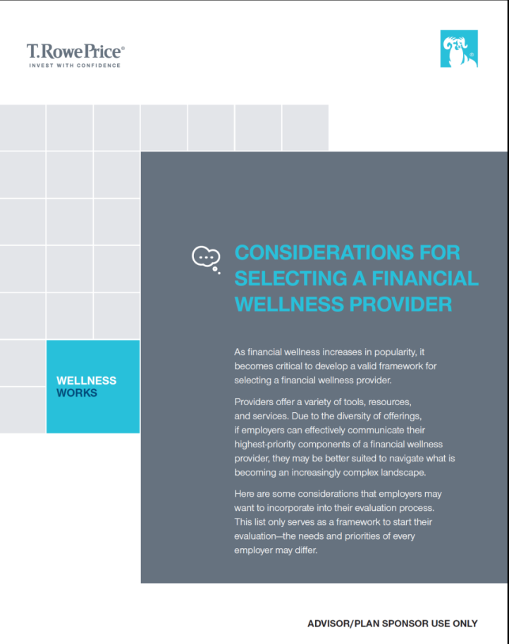
Considerations for selecting a provider
Develop a list of top needs or priorities
Compare your list of needs against the offering of various financial wellness providers
Create a “Request for Information” to gather data from providers to enable a more informed decision-making process

Slide 32
Considerations for selecting a provider
Budget or cost
Multi-media resources
Business model
Data reporting capabilities
Communication frequency
Integration with other benefits
Notes:
Budget:
For many sponsors, this may be the biggest factor in narrowing down the list of potential financial wellness providers. Sponsors can want a robust, comprehensive program all they want, but if they can’t afford it or don’t want to take the time to promote it, then you may have to get creative. From a cost perspective, some considerations are:
Is cost based on all eligible employees for the program, or are only those who enroll charged a fee?
Will the cost be passed through to employees?
Will the sponsor decide to shoulder the per-employee cost?*
* Several prominent opinions exist, including one written by The Groom Law Group, that state that the cost of financial wellness programs is a qualified plan expense that can be paid for out of plan assets (forfeitures, ERISA budgets, etc.).
But regardless of other priorities or needs the sponsor has…it makes sense to start by weighing their budget vs the cost of programs and then go from there.
Business model:
Financial wellness as a topic has exploded very quickly throughout the retirement industry. Because of its current widespread popularity, financial wellness providers seem to be entering the space almost every month—and those that have been in the business a while are constantly enhancing their offer to the marketplace.
But much like the proliferation of target date providers a decade ago or dot-com start-ups from the late 1990s, do they have a strategy for long-term success or are they a flash-in-the-pan outfit? Questions that sponsors should ask a potential provider could include:
Do they have the capacity to grow as my organization grows?
How do they make their money—from advertising, or does their revenue come from cross-selling additional products and services to my workforce? Advisors we’ve spoken with really dig deep on this question. The last thing that a financially stressed workforce needs is the distraction of being pushed products or services that they don’t want or need. Truly product agnostic financial wellness providers seem to have a leg up on their peers who want to cross-sell other products.
Communication Frequency:
How often a financial wellness provider may be sending messages to employees may be an important consideration. Each company develops its own communication culture. Some may pepper their employees with frequent messages, others may prefer to group communications in a newsletter type of format that only goes out weekly, monthly, or quarterly.
Inquire about the timing, frequency, and type of message that the financial wellness provider would typically send. In an ideal world, perhaps they can even synchronize their messages to be complementary to the ones the sponsor is already sending.
What is their client service model for ongoing engagements with [me/the sponsor]?
When you or the sponsor has an issue or a question, to whom do you turn? Does the financial wellness provider have dedicated account or relationship manager? Is it a pooled client service environment? An 800-number?
What is the ongoing cadence of communications after the program is implemented? Will the sponsor know the timing, audience, and message of the communications being sent to their workforce? Is that done without the sponsor’s awareness?
Employees are already receiving a variety of communications at work (benefits announcements, account statements and updates, security warnings, messages from colleagues and managers, as well as client communications). If a financial wellness provider starts sending weekly updates, alerts, or progress reports on top of everything else, there a better chance of the message getting lost in the shuffle or the recipients becoming numb to the message.
Multi-media resources
Each organization’s workforce is unique. And most of the time, it’s not homogeneous. Some employees may have access to computers, laptops, or other mobile devices; while other employees rely more heavily on paper-based communication or call center conversations.
Does the financial wellness provider offer education in a variety of formats?
How is content accessed? Do employees have to go to the financial wellness provider’s site, can the content reside on the employer’s internal websites, or is it a mix of both?
Is content available in paper, electronic, phone-based, and/or face-to-face formats? Which of those might be the highest priority for the employer’s organization?
Data reporting capabilities
Financial wellness providers come in a variety of flavors. Some offer coaches or access to financial professionals. Others link financial accounts to give the user a holistic look at their finances on a weekly or monthly basis. And others are prescriptive in the behaviors that lead to financial wellness, and the order in which employees change each behavior.
All of those examples come with differing abilities to track employees’ progress and measure the success of the program. Sponsors who may be under pressure to demonstrate the effectiveness of a financial wellness program may want to evaluate how detailed the program can be at providing results or progress.
While data reporting capabilities sound like a “must have,” sponsors should keep in mind that this capability is often accompanied by bigger logistical hurdles pertaining to data feeds and access to employee information (which raises questions about data integrity and security as well). Data reporting may also carry with it a heftier price tag for the program.
Integration with other benefits
Financial wellness should be seen as an extension, or another facet, of an employee’s overall benefits package. The better integrated it can be into existing communications about retirement, the better chance the employee has to understand how the benefits fit together. At its core, financial wellness gives employees the capacity to generate additional savings, an important outlet of which is their workplace retirement plan. Other considerations with respect to integration are:
Can messages about financial wellness be incorporated into participant statements?
Can the participant website include financial wellness (or at least a link to obtain more information on the program and resources available)?
Is there an opportunity to incorporate financial wellness information into call center scripts?
Enhancing the visibility and amplifying the presence of the financial wellness program will only help to increase adoption within the workforce.
Bottom line: This is not a rigid, all-encompassing list of considerations. And more importantly, how these considerations are prioritized may vary greatly from sponsor to sponsor – depending on needs and wants. This will get the conversation started so that when it comes time to vet potential providers, you can develop a framework for that evaluation process.

Slide 33
 |  | wellness works
Empower your employees with financial wellness
T. Rowe Price Investment Services, Inc. 2016-US-26450 9/16
Notes:
Two things I want you to leave with today:
This is NOT just another passing fad. Just like auto-services helped to solve the participant inertia and the education barrier, financial wellness serves as the on-ramp to savings for all of the employees that A) are not in auto-services plans, B) may be auto-enrolled and saving but are taking a hit with loans and hardships, or C) are so financially stressed that retirement savings isn’t even on the radar. Financial wellness is the next frontier in the retirement space.
Good things happen – for your employees and your organization– when American workers have their financial house in order.

